Slide 1

INTERNSHIP/TERM PROJECT
PneumoFusionNet
A Multimodal Deep Learning Framework for Pneumonia Detection
Student Name :
Ashutosh Yadav
Student ID :
23035010693
Indian Institute of Technology Guwahati
Email ID :
Ashutosh.Yadav@op.iitg.ac.in
Programme :
BSc. (Hons.) Data Science & AI
Course Code :
DA278
BSc. (Hons.) Data Science & Artificial Intelligence
Online Degree Programme
Course Name :
DA 378 (Internship/Term Project-II
Trimester :
VIII
Notes:
"Hello, my name is Ashutosh Yadav, Roll Number 23035010693, from the B.Sc. Data Science and Artificial Intelligence programme at IIT Guwahati.
This is my Term 8 project presentation on PneumoFusionNet — a multimodal deep learning framework for pneumonia detection using chest X-rays and clinical reports.
This work is inspired by the PneumoFusion-Net paper published in Frontiers in Physiology in March 2025 by Yu et al.
Let me walk you through the complete research journey — from validating our architecture on public datasets, to accessing restricted clinical data, to the surprising failure that changed our direction."

Slide 2
Problem & Motivation
Why do we need a multimodal approach?
🫁 The Clinical Challenge
🔬 The Research Gap
✅ Our Solution
• Pneumonia kills ~2.5M people/year (WHO)
• Chest X-ray = primary diagnostic tool
• Visual ambiguity: pneumonia, effusion,
atelectasis look identical on CXR
• Radiologists disagree ~20% of cases
• AI models focus on image only —
ignoring clinical context
• Existing models: image-only
• Radiologists use:
– Patient history & symptoms
– Lab results (WBC, CRP)
– Written radiology reports
• Adding report text introduces
LABEL LEAKAGE risk
• Restricted clinical data needed
PneumoFusionNet:
• CXR image → ResNet50+DSC+GCSA
• Report text → Bio_ClinicalBERT
• Fusion MLP for final diagnosis
Dataset: MIMIC-CXR (restricted)
• 377,110 radiographs
• Full radiology reports
• Real clinical imbalance (5.6:1)
PneumoFusionNet | IIT Guwahati | Ashutosh Yadav (23035010693)
2 / 10
Notes:
Pneumonia kills approximately 2.5 million people every year. Chest X-ray is the primary diagnostic tool because it's fast and affordable.
But reading a chest X-ray is genuinely difficult. The same cloudy area can look like pneumonia, fluid buildup, or a collapsed lung section. Even expert radiologists disagree about 20% of the time.
Existing AI models are image-only — they ignore the clinical context that every real doctor uses: patient symptoms, lab results, and the written radiology report.
Adding the report text should help resolve this ambiguity. But there's a critical trap called label leakage — if the model reads the radiologist's final conclusion during training, it simply memorises the answer instead of actually learning to diagnose.
Our solution — PneumoFusionNet — handles this with a strict anti-leakage pipeline and uses the restricted MIMIC-CXR hospital database.

Slide 3
Pilot Architecture: ResNet50 + DSC + GCSA
Stage 0 — Custom image classification backbone
1️⃣ ResNet50 Backbone
2️⃣ Depthwise Separable Conv (DSC)
3️⃣ Global Context Spatial Attn (GCSA)
• Pretrained on ImageNet (1.2M images)
• Adapted for grayscale CXR input
(RGB weights averaged → 1 channel)
• First 7 layers FROZEN
• Output: 2048-channel feature map
Role: Extract general visual features
from chest X-ray images
• Compresses 2048 → 1024 channels
• ~50% fewer parameters vs standard conv
DSC(X) = BN(ReLU(W₁ₓ₁ * (W_dw ⊛ X)))
• Depthwise conv: per-channel filtering
• Pointwise 1×1: channel mixing
Role: Efficient feature compression
• Channel attention: WHAT to focus on
A_ch = σ(MLP(AvgPool) + MLP(MaxPool))
• Spatial attention: WHERE to focus
A_sp = σ(Conv₇ₓ₇([AvgCh; MaxCh]))
• Combined: X̂ = X · A_ch · A_sp
Role: Focus on lung pathology regions
→
→
Final output: 1024-dimensional image feature vector
PneumoFusionNet | IIT Guwahati | Ashutosh Yadav (23035010693)
3 / 10
Notes:
Before touching any clinical data, we designed and validated a custom image backbone consisting of three components.
First, ResNet50 — a standard deep learning backbone pretrained on ImageNet. We adapted its first convolutional layer to accept single-channel grayscale X-ray images by averaging the pretrained RGB weights.
Second, Depthwise Separable Convolution — DSC — this compresses the 2048-channel ResNet output to 1024 channels using approximately 50% fewer parameters compared to a standard convolution. The mathematical formulation is shown on screen.
Third, Global Context Spatial Attention — GCSA — this tells the network what features to focus on through channel attention, and where in the image to look through spatial attention. Together, they help the model concentrate on the actual pathological regions in the lung.
The final output is a 1024-dimensional image feature vector

Slide 4
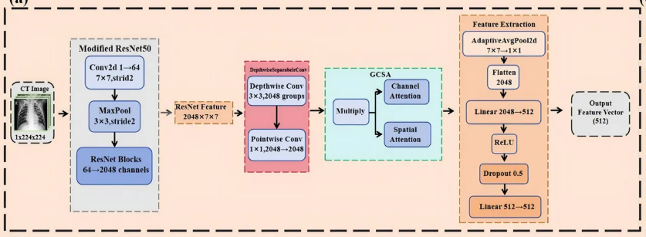

Slide 5
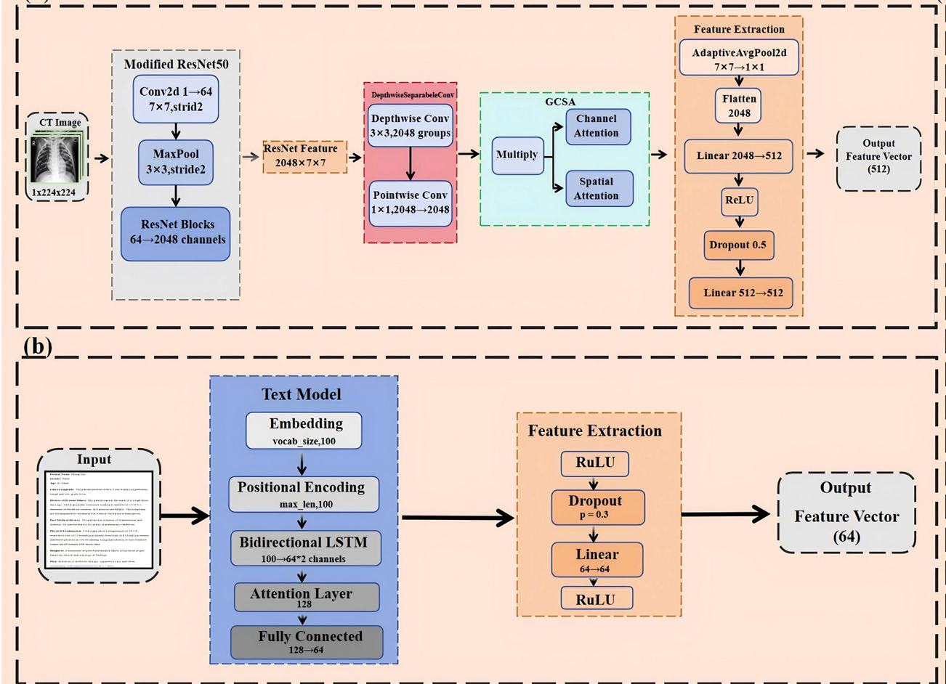

Slide 6
Stage 0: Public Dataset Results + Dataset Search
Validation on Kaggle & IU → Why MIMIC-CXR?
📊 Stage 0 Results on Public Datasets
🔍 Why MIMIC-CXR?
Notebook
Dataset
Purpose
Result
Need 3 modalities simultaneously:
1. Chest X-ray images
2. Clinical data (symptoms, labs)
3. Radiology reports (FINDINGS + IMPRESSION)
Evaluated: Kaggle ✗ IU X-Ray ✗ NIH ✗ CheXpert ✗
MIMIC-CXR-JPG v2.0.0 ✅
• 377,110 radiographs, 65,379 patients
• Paired images + full radiology reports
• Real 5.6:1 class imbalance
• Mixed PA/AP/Lateral views
🔒 Access: CITI training + PhysioNet DUA required
Not publicly downloadable
v1_Basic_Image_Model
Kaggle CXR
Sanity check
~92% Acc ✓
v2_Enhanced_GCSA_DSC
Kaggle CXR
DSC+GCSA valid.
92% Acc, F1=0.91 ✓
v3-1-iu-multimodal-image
IU X-Ray
Image baseline
Pipeline ✓
v3-2-iu-multimodal-text
IU X-Ray
Image+text e2e
Pipeline ✓
⚠ 92% on Kaggle = code correct, NOT clinical readiness.
Pre-cleaned, balanced Kaggle ≠ real hospital data.
PneumoFusionNet | IIT Guwahati | Ashutosh Yadav (23035010693)
4 / 10
Notes:
"We validated this architecture on public datasets first.
On the Kaggle Chest X-Ray dataset — 5,216 images — we achieved 92% accuracy and F1 of 0.91. The IU X-Ray experiments confirmed that our multimodal pipeline code ran correctly end-to-end.
However — and this is important — 92% on Kaggle only confirms the code is correct. It says nothing about clinical readiness. Kaggle data is pre-cleaned, balanced, and far too easy compared to real hospital data.
So we searched for a better dataset. We needed three things simultaneously: chest X-ray images, clinical history, and full radiology reports with separate FINDINGS and IMPRESSION sections.
After evaluating Kaggle, IU, NIH, and CheXpert, we identified MIMIC-CXR-JPG as the only dataset meeting all requirements.
But MIMIC-CXR is not publicly downloadable. Accessing it required completing CITI Program ethics training and signing a PhysioNet Data Use Agreement.

Slide 7
Anti-Leakage Pipeline & System Architecture
The critical design decision that makes multimodal training valid
⚠ What is Label Leakage?
Phase 1 — Image Branch
Phase 2 — Text Branch
Every radiology report has an IMPRESSION section
containing the radiologist's final diagnosis.
If the model reads IMPRESSION during training,
it memorises the ANSWER instead of learning!
✅ INDICATION: Patient with fever, cough → KEPT
✅ FINDINGS: Consolidation in left lower lobe → KEPT
❌ IMPRESSION: Pneumonia confirmed. → STRIPPED
CXR Image (PA only)
Report Text
↓
↓
ResNet50 Backbone
Strip IMPRESSION ✘
↓
↓
DSC: 2048→1024 ch.
Bio_ClinicalBERT
↓
↓
GCSA Attention
768-d Vector
↓
🔧 rebuild_dataset_findings.py
1024-d Vector
1. Parse report into named sections
2. RETAIN: INDICATION + FINDINGS
3. STRIP: IMPRESSION + CONCLUSION
4. Export leakage-free CSV for training
Concat [1024 + 768 = 1792-d] → Fusion MLP → Normal / Pneumonia
PneumoFusionNet | IIT Guwahati | Ashutosh Yadav (23035010693)
5 / 10
Notes:
efore running a single experiment on MIMIC-CXR, we built our anti-leakage data pipeline. This is the most critical design decision in the entire project.
Every radiology report has an IMPRESSION section — the radiologist's final written diagnosis. If our model ever reads this during training, it's not learning to diagnose — it's just reading the answer.
We developed a script called rebuild_dataset_findings.py that parses every report, retains the INDICATION and FINDINGS sections which contain pre-diagnosis clinical evidence, and completely strips the IMPRESSION and CONCLUSION sections.
The system architecture works in two phases shown on the right: The image branch passes through ResNet50, DSC, and GCSA to produce a 1024-dimensional vector. The text branch feeds the leakage-free report into Bio_ClinicalBERT — a BERT model pretrained on millions of clinical notes — producing a 768-dimensional vector.
Both vectors are concatenated into 1792 dimensions and classified by a fusion MLP

Slide 8
Stage 1: MIMIC-CXR Pilot Study — 139 Samples
Four phases of systematic experimentation
📁 Pilot Dataset
📊 Four-Phase Pilot Results
• 139 samples (118 Normal, 21 Pneumonia)
• Class imbalance: 5.6:1
• All views: PA, AP, Lateral
• Split: 97 train / 21 val / 21 test (70/15/15)
Phase
Configuration
AUC
Acc.
F1
1
Image only, imbalanced (118:21)
0.667
76.2%
0.430
1.1
Image only, balanced (21:21)
0.917
85.7%
0.857
2
Image+Text, imbalanced (118:21)
0.704
81.0%
0.447
💡 Key Finding
Adding LEAKAGE-FREE text
(FINDINGS + INDICATION only)
improved AUC by +3.7%
on the realistic imbalanced split.
IMPRESSION was NEVER shown
to the model during training.
2.1
Image+Text, balanced (21:21)
0.917
71.4%
0.708
Leakage-free gain (Ph.2 vs Ph.1, imbalanced):
+0.037
+4.8%
+0.017
PneumoFusionNet | IIT Guwahati | Ashutosh Yadav (23035010693)
6 / 10
Notes:
For the pilot study, we extracted 139 samples from MIMIC-CXR — 118 Normal and 21 Pneumonia — giving a 5.6 to 1 class imbalance. We ran four systematic phases.
Phase 1 — image only, realistic imbalanced split: AUC of 0.667.
Phase 1.1 — image only, artificially balanced: AUC jumps to 0.917. But as we'll see, this number is misleading.
Phase 2 — image plus leakage-free text, imbalanced: AUC improves to 0.704 — that's a genuine +3.7% gain over Phase 1.
Phase 2.1 — image plus text, balanced: AUC of 0.917 again.
The key result is in the green row — on the realistic imbalanced split, adding text from FINDINGS and INDICATION — with IMPRESSION completely stripped — genuinely helped the model.
This proves that the clinical text contains real diagnostic signal beyond what the image shows

Slide 9
Statistical Honesty: The N=7 Problem
Why 0.917 AUC means nothing — and why we must scale up
🔢 The Problem
📌 What This Means
Balanced test set had exactly 7 samples.
ONE misclassification = 14.28% accuracy swing.
95% CI formula: CI = p ± 1.96 × √(p(1-p)/N)
AUC = 0.917 on N = 7 samples
is STATISTICALLY MEANINGLESS.
The honest answer requires scaling up to
a proper clinical test set (N ≥ 200+).
This is not a failure — it is scientific
rigour. Documenting this gap is one of
the most important contributions
of Part 1.
→ SOLUTION: Scale up to 1,989 PA-only
images with patient-level splits.
📉 Confidence Intervals
Phase 1.1 (Image only, balanced):
AUC reported: 0.917
Accuracy: 85.7% ± 25.9%
95% CI: [59.8%, 100%] ← HUGE range!
Phase 2.1 (Image+Text, balanced):
Accuracy: 71.4% ± 33.5%
95% CI: [38.0%, 100%]
Fisher's Exact Test: p ≈ 1.000
→ Difference is STATISTICALLY INSIGNIFICANT
PneumoFusionNet | IIT Guwahati | Ashutosh Yadav (23035010693)
7 / 10

Slide 10
Stage 2: Scale-Up — Architecture FAILS
1,989 PA-only images, patient-level splits → AUC drops to 0.713
📁 Scale-Up Dataset
❌ Pilot Architecture at Scale — Results
• 1,989 PA-only images
(1,062 Normal + 927 Pneumonia)
• PA-only: eliminates view-type confound
• Patient-level GroupShuffleSplit
by subject_id (zero patient overlap)
• 1,401 train / 295 val / 293 test
Metric
Pilot (N=7)
Scale-Up (N=293)
AUC-ROC
0.917 (unreliable)
0.713 ❌
Accuracy
85.7% (unreliable)
66.2% ❌
Sensitivity
—
69.9% ❌
Specificity
—
63.5% ❌
🔍 Root Cause Analysis
F1 (macro)
0.857 (unreliable)
0.660 ❌
1. ImageNet domain mismatch
Natural images ≠ chest X-ray pathology
2. Insufficient training data (1,401 imgs)
Cannot override ImageNet representations
3. Clinical data complexity
Devices, overlapping anatomy, varied exposure
Confusion Matrix (N=293): TN=108, FP=62, FN=37, TP=86
PneumoFusionNet | IIT Guwahati | Ashutosh Yadav (23035010693)
8 / 10
Notes:
But here is where scientific honesty becomes critical.
The balanced test set had exactly seven samples. One misclassification changes the accuracy by 14.28 percent.
Using the standard 95% confidence interval formula, Phase 1.1's accuracy of 85.7% has a confidence interval of 59.8% to 100% — an enormous range.
A Fisher's Exact Test gives p approximately equal to 1.0 — the difference between phases is completely statistically insignificant.
The AUC of 0.917 on 7 samples is statistically meaningless.
Documenting this gap honestly is one of the most important scientific contributions of Part 1. We cannot make clinical claims from 7 test samples. We must scale up — and that is exactly what we did next.

Slide 11
Key Findings — Part 1 Summary
Four critical lessons from the MIMIC-CXR experiments
1
2
3
4
Public ≠ Clinical
Anti-Leakage Text Works
N=7 is Meaningless
Architecture Must Change
92% on Kaggle → 66.2% on MIMIC-CXR.
Public benchmarks give dangerously false confidence.
+3.7% AUC from FINDINGS+INDICATION.
Stripping IMPRESSION was essential — and it worked.
AUC=0.917 on 7 samples has CI=[59.8%, 100%].
The honest N=293 answer is AUC=0.713.
ResNet50+DSC+GCSA fails at clinical scale.
ImageNet pretraining fundamentally mismatched for CXR.
PneumoFusionNet | IIT Guwahati | Ashutosh Yadav (23035010693)
9 / 10
Notes:
Part 1 delivered four critical findings.
Finding 1: Public benchmarks do not predict clinical performance. 92% on Kaggle became 66% on real hospital data.
Finding 2: The anti-leakage text pipeline works. Stripping IMPRESSION and using only FINDINGS produced a genuine +3.7% AUC gain.
Finding 3: Small test sets are statistically meaningless. AUC of 0.917 on 7 samples has a confidence interval spanning the entire range from 59% to 100%.
Finding 4: The architecture must change. ResNet50 with ImageNet pretraining cannot handle clinical-scale CXR pathology detection. A different backbone is required

Slide 12
Conclusion & Part 2 Roadmap
The pivot to DenseNet-121 — solving the domain mismatch
✅ Part 1 Delivered
🏥 Why DenseNet-121?
1. Anti-leakage data pipeline (100% leakage-free)
2. Proof: public results ≠ clinical performance
3. Honest failure: AUC=0.713 at N=293
4. Root cause: ImageNet domain mismatch
5. Statistical rigour: CI analysis, Fisher's test
ResNet50 (ImageNet pretrained):
Trained on: cats, dogs, cars, furniture...
AUC on MIMIC-CXR: 0.713 ❌
DenseNet-121 (torchxrayvision):
Trained on: CheXpert + NIH ChestX-ray14
+ MIMIC-CXR (>500,000 CXRs!)
Every weight learned from real X-rays
Expected AUC: ~0.85+ ✅
Dense connections = better gradient flow
for medical imaging feature reuse.
This is the ONLY fix for domain mismatch
without 10× more training data.
🚀 Part 2 Roadmap
1. DenseNet-121 (torchxrayvision)
Pretrained on >500K real CXRs
→ Directly fixes domain mismatch!
2. Scale to 1,989+ PA images, patient splits
3. Bio_ClinicalBERT + cross-attention fusion
4. MIMIC-IV lab values (WBC, CRP, PCT)
5. 5-fold GroupKFold cross-validation
PneumoFusionNet | IIT Guwahati | Ashutosh Yadav (23035010693)
10 / 10
Notes:
To summarise Part 1 — we delivered three contributions: a robust anti-leakage data pipeline, rigorous proof that public dataset results don't transfer to clinical environments, and an honest failure at scale that tells us exactly what to do next.
The solution is on the right — DenseNet-121 from the torchxrayvision library, pretrained on over 500,000 actual chest X-rays from CheXpert, NIH ChestX-ray14, and MIMIC-CXR itself. Every weight in this network was learned from real radiological images. This directly solves the domain mismatch failure we observed.
For Part 2, we will scale to the full 1,989-image dataset with patient-level splits, add Bio_ClinicalBERT text fusion with cross-attention, incorporate MIMIC-IV lab values as a third modality, and use 5-fold GroupKFold cross-validation for statistically robust evaluation.
Thank you for watching. The full code is available on GitHub, and all MIMIC-CXR data access follows the PhysioNet DUA requirements.

